Slide 2
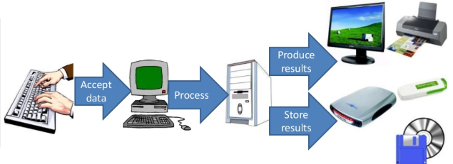
What is Computer
A computer is an electronic device, operating under the control of instructions stored in its own memory, that can accept data, process the data according to specified rules, produce results, and store the results for future use.

Slide 3
Advantages of Computers
Following are certain advantages of computers.
High Speed
Computer is a very fast device.
It is capable of performing calculation of very large amount of data.
The computer has units of speed in microsecond, nanosecond, and even the picosecond.
It can perform millions of calculations in a few seconds as compared to man who will spend many months to perform the same task.

Slide 4
Advantages of Computers
Following are certain advantages of computers.
Accuracy
In addition to being very fast, computers are very accurate.
The calculations are 100% error free.
Computers perform all jobs with 100% accuracy provided that the input is correct.

Slide 5
Advantages of Computers (continuation)
Storage Capacity
Memory is a very important characteristic of computers.
A computer has much more storage capacity than human beings.
It can store large amount of data.
It can store any type of data such as images, videos, text, audio, etc.

Slide 6
Advantages of Computers (continuation)
Diligence
Unlike human beings, a computer is free from monotony, tiredness, and lack of concentration.
It can work continuously without any error and boredom.
It can perform repeated tasks with the same speed and accuracy.

Slide 7
Advantages of Computers (continuation)
Versatility
A computer is a very versatile machine.
A computer is very flexible in performing the jobs to be done.
This machine can be used to solve the problems related to various fields.
At one instance, it may be solving a complex scientific problem.

Slide 8
Advantages of Computers (continuation)
Reliability
A computer is a reliable machine.
Modern electronic components have long lives.
Computers are designed to make maintenance easy.

Slide 9
Advantages of Computers (continuation)
Automation
Computer is an automatic machine.
Automation is the ability to perform a given task automatically. Once the computer receives a program i.e., the program is stored in the computer memory, then the program and instruction can control the program execution without human interaction.

Slide 10
Advantages of Computers (continuation)
Reduction in Paper Work and Cost
The use of computers for data processing in an organization leads to reduction in paper work and results in speeding up the process.
As data in electronic files can be retrieved as and when required, the problem of maintenance of large number of paper files gets reduced.
Though the initial investment for installing a computer is high, it substantially reduces the cost of each of its transaction.

Slide 11
Disadvantages of Computers
Following are the certain disadvantages of computers.
No I.Q.
.
Each instruction has to be given to the computer. A computer is a machine that has no intelligence to perform any task
A computer cannot take any decision on its own.

Slide 12
Disadvantages of Computers (continuation)
Dependency
It functions as per the user’s instruction, thus it is fully dependent on humans.
Environment
The operating environment of the computer should be dust free and suitable.

Slide 13
Disadvantages of Computers (continuation)
No Feeling
Computers have no feelings or emotions.
It cannot make judgment based on feeling, taste, experience, and knowledge unlike humans.

Slide 14
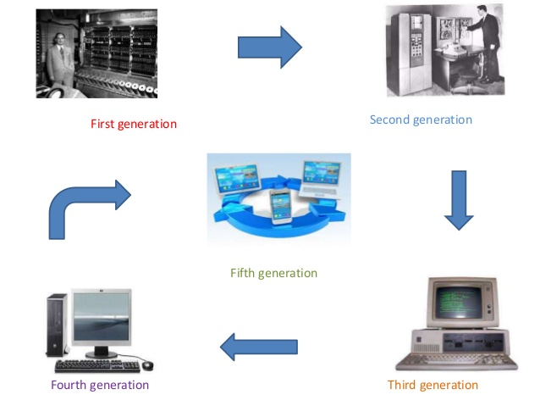
Generation of Computer

Slide 15
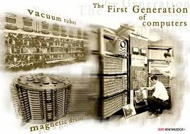
Generation of Computer
The First Generation (1940-1956)
were based on the use of wired circuits containing vacuum tubes
utilized punch cards as the main storage medium
design for specific task
Used machine language for computing

Slide 16
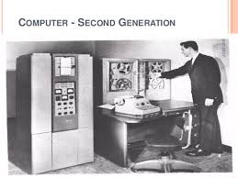
Generation of Computer
The Second Generation (1956-1963)
development of the transistor
smaller size and increased reliability
faster and more energy-efficient than their predecessors
used assembly language

Slide 17
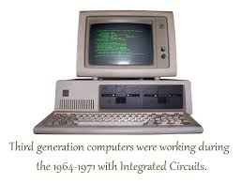
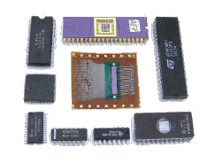
Generation of Computer
The Third Generation (1964 – 1971)
Use Integrated Circuits
The first integrated circuit (IC)
Was invented independently by Jack Kilby and Robert Noyce

Slide 18
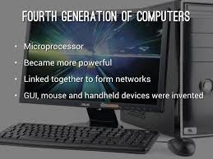
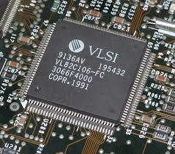
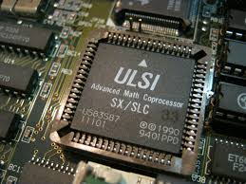
Generation of Computer
The Fourth Generation (1971-present)
Development of user-friendly software packages
Use of Microprocessor
very-large-scale-integration and
ultra-large-scale-integration

Slide 19
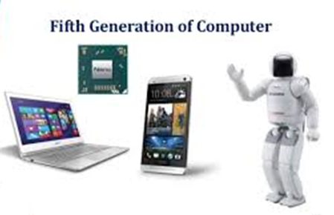
Generation of Computer
The Fifth Generation – Present and Beyond: Artificial Intelligence
Artificial intelligence
Expert systems
Natural language processing

Slide 20
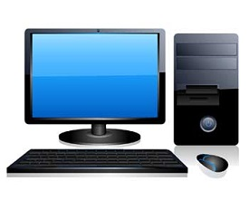
Classification of Computer
No | Type | Specifications
1 | PC (Personal Computer) | It is a single user computer system having moderately powerful microprocessor

Slide 21
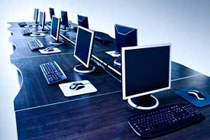
Classification of Computer
No | Type | Specifications
2 | Workstation | It is also a single user computer system, similar to personal computer however has a more powerful microprocessor.

Slide 22
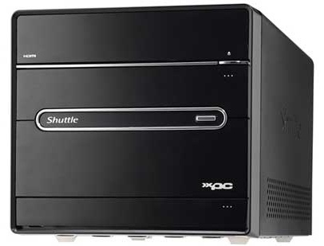
Classification of Computer
No | Type | Specifications
3 | Mini Computer | It is a multi-user computer system, capable of supporting hundreds of users simultaneously.

Slide 23
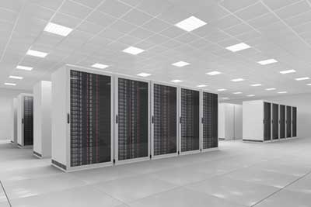
Classification of Computer
No | Type | Specifications
4 | Main Frame | It is a multi-user computer system, capable of supporting hundreds of users simultaneously. Software technology is different from minicomputer.

Slide 24
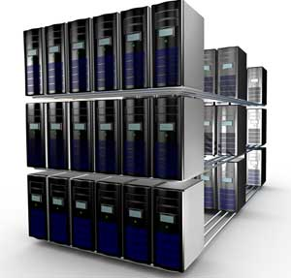
Classification of Computer
No | Type | Specifications
5 | Super computer | It is an extremely fast computer, which can execute hundreds of millions of instructions per second.

Slide 25
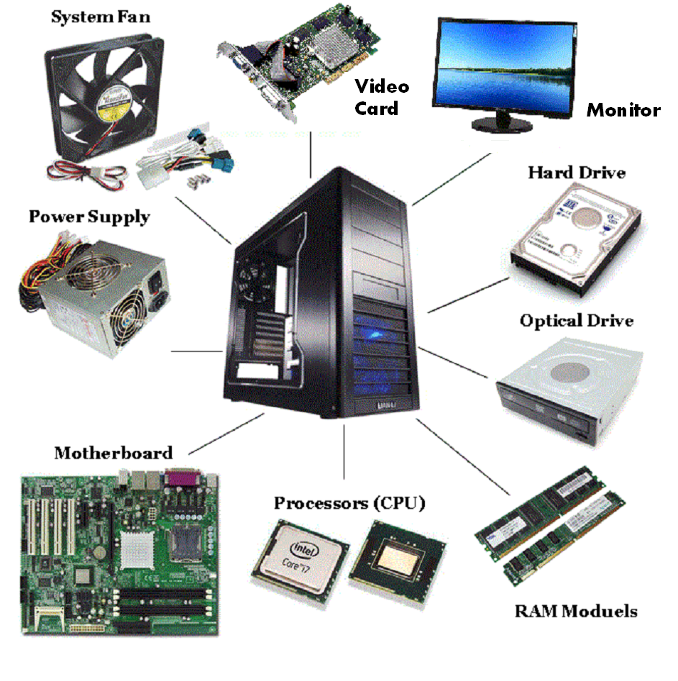
INTRODUCTION TO COMPUTER
BASIC COMPONENTS OF COMPUTER
Computer Hardware – Mounted within the computer case and some are also connected externally. Well known as the tangible part of the computer system.

Slide 26
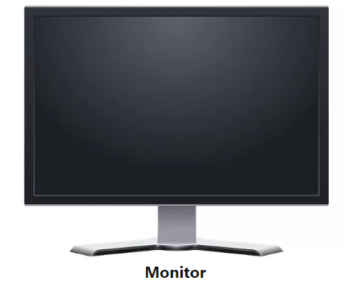
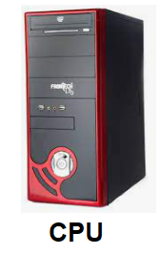
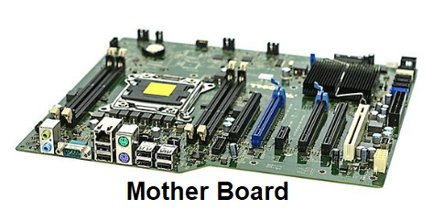
INTRODUCTION TO COMPUTER
TYPES OF HARDWARE COMPONENTS:
Monitor – It displays the result.
CPU – Central Processing Unit that controls the computer functions and transmit data.
Mother Board – It is mainly accountable to establish communication between components and transmission of information.

Slide 27
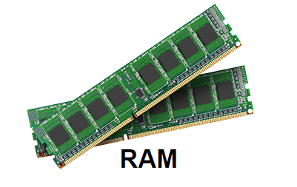
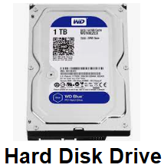
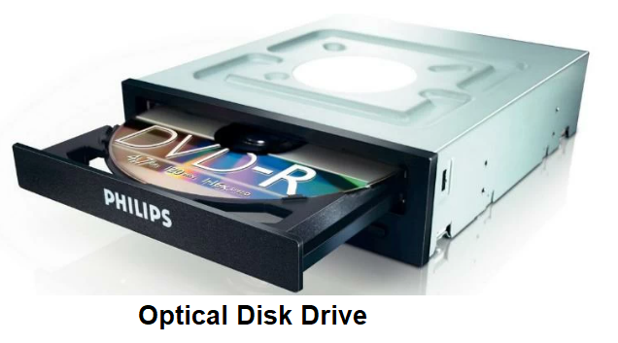
INTRODUCTION TO COMPUTER
TYPES OF HARDWARE COMPONENTS:
RAM – It is the Random Access Memory and responsible for the storage of programs that are currently running and also stores data temporarily.
Hard Disk Drive – Permanent storage device.
Optical Disk Drive – It is a device that also store data

Slide 28
INTRODUCTION TO COMPUTER
INPUT AND OUTPUT DEVICES:
Input Devices – Hardware devices that sends data to a computer allowing you to interact with and control it. Example: Mouse, Keyboard, Scanner, Touchpad etc.
Output Devices – Hardware devices which transmit data from a computer into information that can read by a human. Example: Monitor, Printer, Projector, Speaker etc.

Slide 29
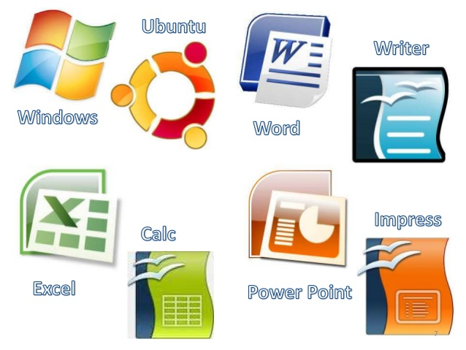
INTRODUCTION TO COMPUTER
BASIC COMPONENTS OF COMPUTER
Computer Software – Is a set of programs which is designed to perform a well-defined function. A program is a sequence of instructions written to solve problem. Well know as the intangible part of the computer.

Slide 30
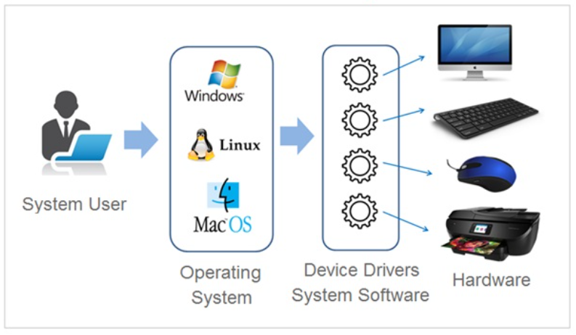
INTRODUCTION TO COMPUTER
2 TYPES OF COMPUTER SOFTWARE
System Software – Collection of programs designed to operate, control and extend the processing capabilities of the computer system and other hardware devices connected to the computer system.

Slide 31
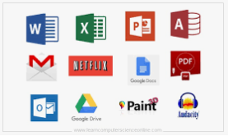
INTRODUCTION TO COMPUTER
2 TYPES OF COMPUTER SOFTWARE
Application Software – Provides an interface to the computer user to perform a specific job on the computer system. Application software are installed on the system to provide specific functionality of the system. Example:

Slide 32

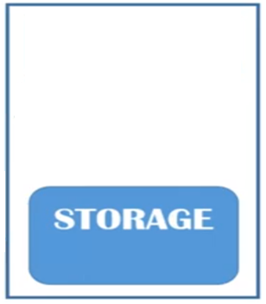









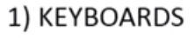
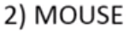

INTRODUCTION TO COMPUTER
How Computer Works

Slide 33
INTRODUCTION TO COMPUTER
Computing Environments – Is a collection of computers which are use to process and exchange information to solve various types of computing problems. It includes computer machinery, data storage devices, workstations, software applications and network that support the processing and exchange of electronic information demanded by software solutions.

Slide 34
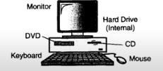
INTRODUCTION TO COMPUTER
TYPES OF COMPUTING ENVIRONMENT
Personal computing – Is a single computer system incorporates complete program on a computer and performs it. This type of computing environment is for single users to run task.

Slide 35
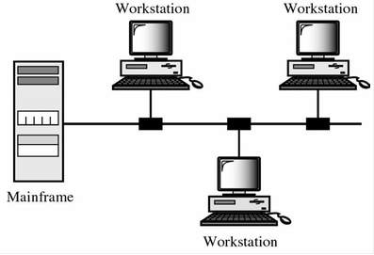
INTRODUCTION TO COMPUTER
TYPES OF COMPUTING ENVIRONMENT
Time-Sharing – Is enables multiple users to share concurrently, it allows various time slots for various users and processes.

Slide 36
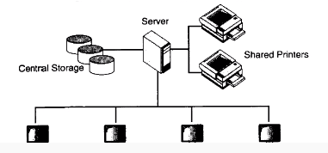
INTRODUCTION TO COMPUTER
TYPES OF COMPUTING ENVIRONMENT
Client/Server Environment – Is a distribute computing model in which the client requests services from the server, it includes a client machine and a server machine.

Slide 37
INTRODUCTION TO COMPUTER
COMPUTER LANGUAGES – Are used to give instructions to the computer in a language which a computer can understand. Also defined as a code or syntax which is use to write programs or any specific applications. Also known as programming languages or simply computer languages.

Slide 38
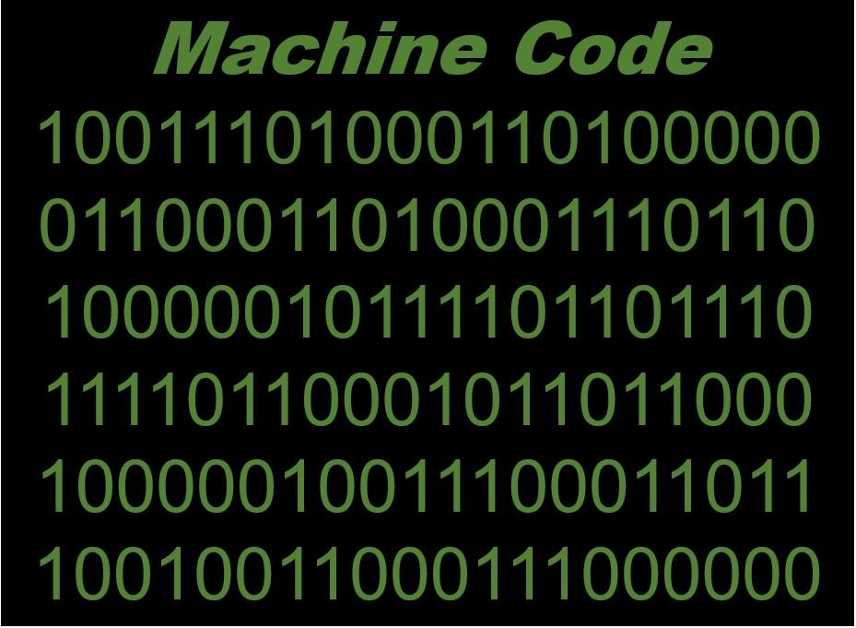
INTRODUCTION TO COMPUTER
CLASSIFICATION OF COMPUTER LANGUAGE
Machine Language – Is a type of low-level programming language which a program written in binary code can be directly entered for execution. Its memory can only stored 1’s and 0’s, instructions must be given to the computer in streams of 1’s and 0’s like binary code. Considered as the oldest computer language.

Slide 39
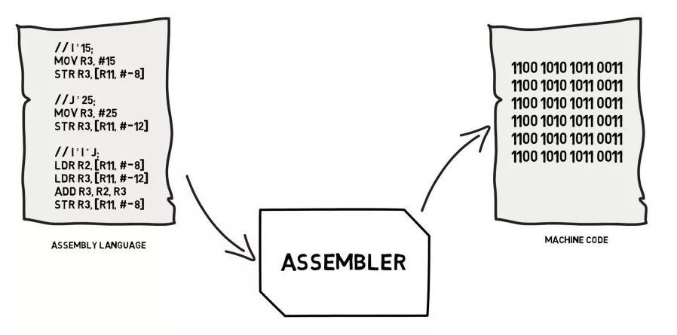
INTRODUCTION TO COMPUTER
CLASSIFICATION OF COMPUTER LANGUAGE
Symbolic Language – Also called assembly language, which is a type of low-level programming language that is intended to communicate directly with computer’s hardware. Unlike machine language which consist of binary and hexadecimal characters. Also called assembly language which encoding of machine code that makes simpler and readable.

Slide 40
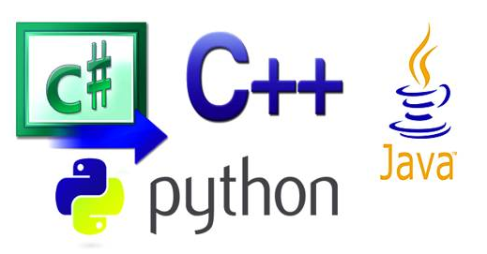
INTRODUCTION TO COMPUTER
CLASSIFICATION OF COMPUTER LANGUAGE
High-Level Language – Is any programming language that enables development of a program in a much more user-friendly programming context and generally independent of the computer’s hardware architecture. Example of high-level language are Python, Java, C++, C#, Visual Basic, JavaScript etc.

Slide 41
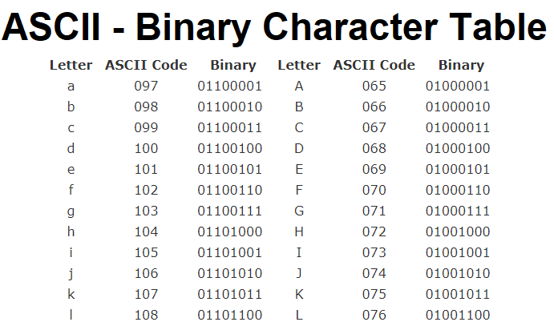
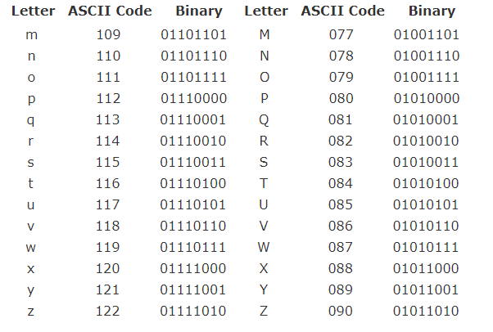
INTRODUCTION TO COMPUTER

Slide 42
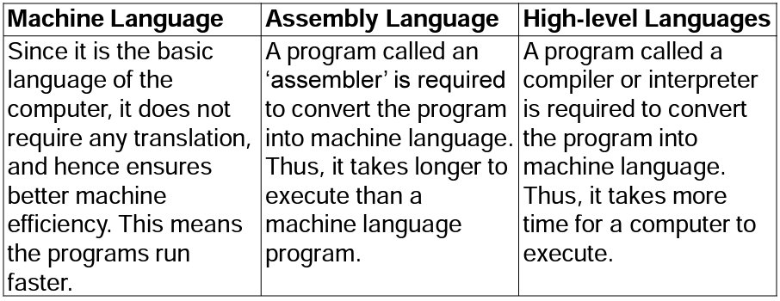
Translator – A translator or programming language processor that converts a computer program from one language to another.
3 Types of Translator

Slide 43
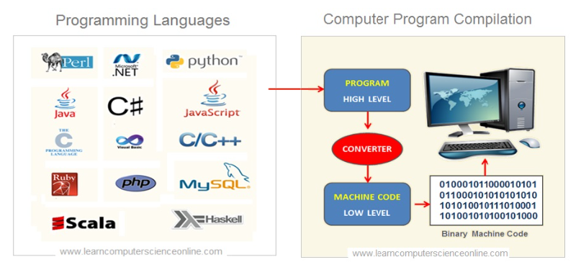
INTRODUCTION TO COMPUTER

Slide 44
REFERENCES
Website:
Fungsi Motherboard Processor Memori Dan Harddisk | Computer hardware, Computer hardware store, Computer Pinterest. https://www.pinterest.ph/pin/88594317657692933/?mt=login
Unit 4 - Hardware & Ergo - Davids BTA30 Portfolio 2016 Sites.google.com. https://sites.google.com/site/davidsbtaportfolio/unit-4---hardware-ergo.
Computer Software Icon #229946 - Free Icons Library. Icon-library.com. https://icon-library.com/icon/computer-software-icon-14.html
https://edu.gcfglobal.org/en/word2016/understanding-onedrive/1/
https://www.rapidtables.com/code/text/ascii-table.html
https://www.vskills.in/certification/tutorial/ms-word-interface-and-editing-document/
https://itsourcecode.com/ms-word/ms-word-window-explore-its-features/

Slide 45
--- END ---

